Slide 1

How might we help disadvantaged youth gain the skills required to get a job?

Slide 2

Ana, age 21
2nd generation immigrant
Low income family
High School Graduate
“I would be great to have someone to verify if this is the right move, should I be doing this… just ask for advice”
Notes:
Ultimately, this is about Ana… a young girl from a low income family, motivated to learn but been shut down of opportunities to do so...

Slide 3
1 in 3 young people will grow up
without a mentor
”It would be great to have someone to verify if this is the right move… just ask for advice”
The Mentoring Effect: Young People’s Perspectives on the Outcomes and Availability of Mentoring
Notes:
This is the same story for many young people, which live in a world that doesn’t provide them with the resources they need to succeed, nor the opportunity to meet with professionals that can inspire them to learn and improve their skills…

Slide 4
Assistance and guidance
is needed for mentee and mentor
”It’s always difficult to ask the right question… you always feel like you don’t know enough”
Notes:
….and even when they are able to find a mentor, it can be a very intimidating and nerve-wracking experience, not knowing what to ask or how to interact...

Slide 5
61%
70%
Inefficient & tedious
of companies provided paid time off to volunteer in 2016
Of professionals would mentor young people if asked
professionals are not satisfied with traditional methods of mentoring
Notes:
From a mentor perspective, we found in our research that, first of all, there is a clear ability to build partnership with companies like Bloomberg to recruit quality mentors, and these professionals are already willing to help young people reach their full potential, even though there were some clear inefficiencies that we had to fix...

Slide 6
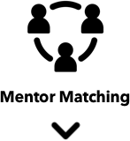


Notes:
We created an easy to access, engaging and effective online platform to democratize access to mentors while also providing youth the opportunity to learn by doing, because we believe that learning should be practical rather than theoretical

Slide 7
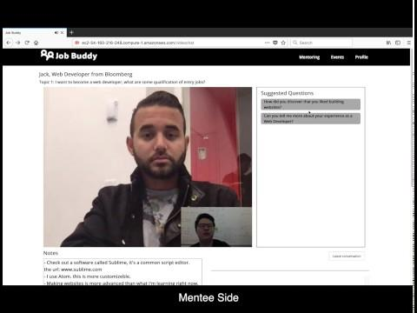
DEMO / VIDEO
Notes:
So here is our product called Job Buddy, we built website because we found out that most of the disadvantaged youth they use shared computers in the public libraries to learn things online.
And here we can see two landing pages respectively for mentee and mentor. They can start signing up and building up their profiles.
By clicking the yellow bubbles here, mentee will tell Job Buddy what they want to learn from the mentors, it could either be a career path or a specific skill. And mentors need to tell Job Buddy what they want to teach.
Our algorithm will use this profile and other background information to match the most suitable mentors to mentee. Comparing to traditional way of mentoring, this saves a lot of time and effort in the process prior to the actual mentoring session. And here we see a list of matched mentors that are currently available now. Let's click to meet Jack.
According to our research, without a specific goal or plan, mentee and mentor will be easily get lost during mentoring. So while waiting to be connected to the mentor, at this page, mentee need to fill up the meeting agenda with question or topics that the mentee wants to discuss with the mentor. Mentee will also be given topic suggestion, so they can be better prepared easily.
As they meet, mentor and mentee can use video to meet each other with a sense of personal connection.
And here we have another feature called Suggested Questions, which will give mentee prompts in order to help them come up with questions or to articulate their questions better in a way that can facilitate the communication. Similar feature will exist on mentor side to guide mentors to conduct a better mentoring session. This feature, together with previously mentioned the meeting agenda feature, really separated us from other general mentoring tool. It really creates a more engaging and enjoyable mentoring experience.
As mentoring session finishes, mentee will be given assignment, and mentee will need to present the findings from the assignment next time when they meet. This continuity will create a more long term engaging experience.

Slide 8


OUR PRODUCT ARCHITECTURE
{REST}
Website
HTML / JS / CSS
Database
SQLite3
RESTful API
Flask
VIEW
MODEL
CONTROL
Notes:
In the technical part, we use MVC architecture to stand up our product. We built our web service based on flask RestfulAPI, using docker to deploy on the AWS and we used SQLite3 for storing the user information

Slide 9
OUR PRODUCT IMPLEMENTATION
WE BUILT…
Video chatting capabilities using Red5 and Vidyo
Matching Algorithm using wide FFM in the deep
Question Bot for better engagement during mentoring session
Smart Agenda to encourage preparation & thoughtful conversation

Slide 10
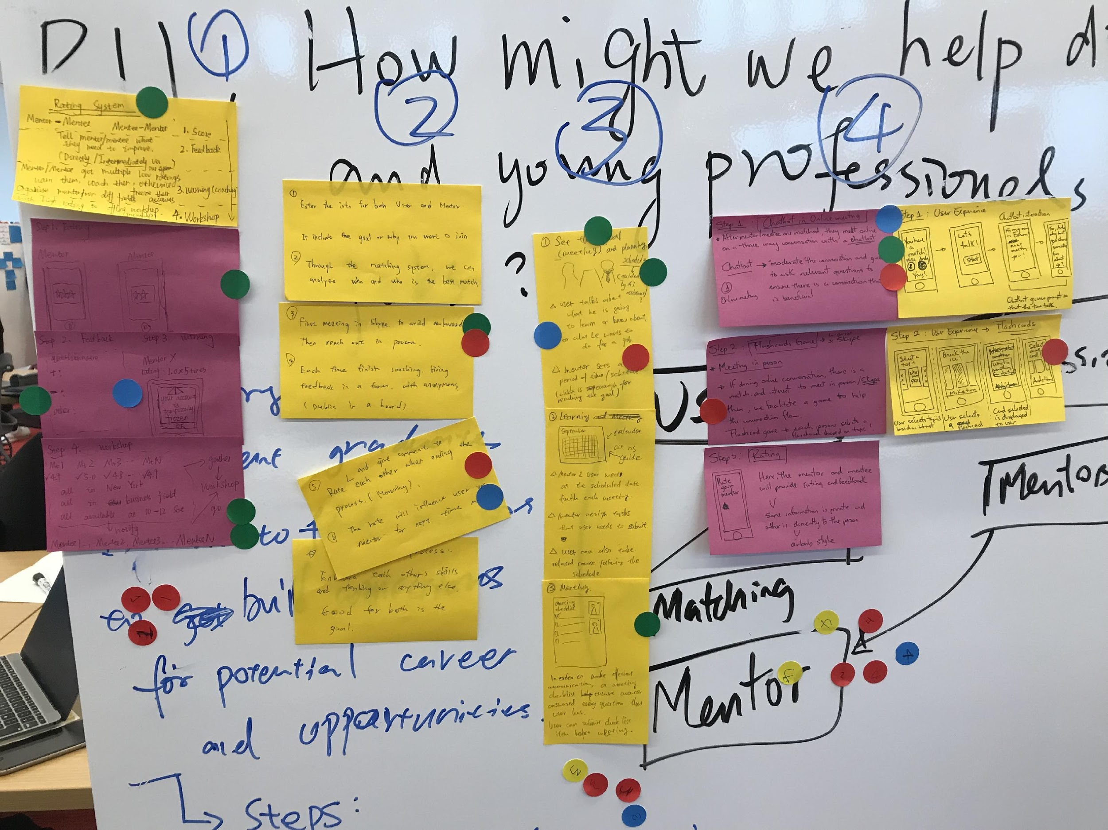
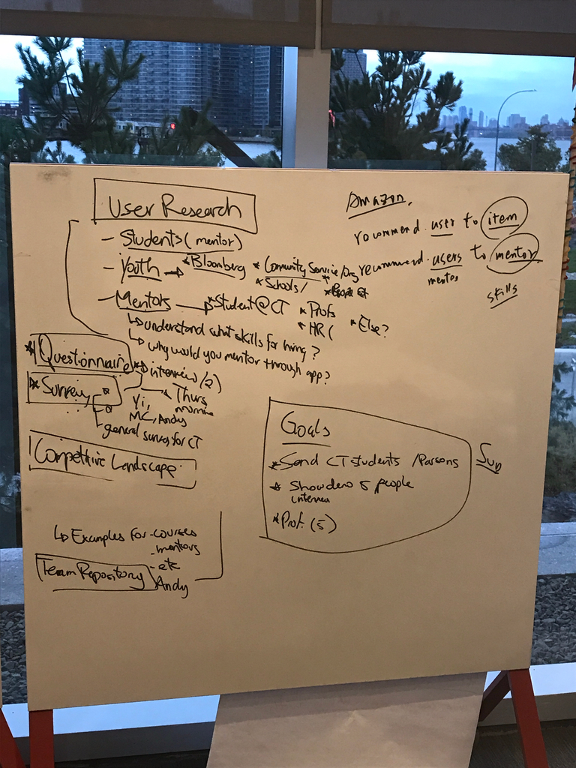
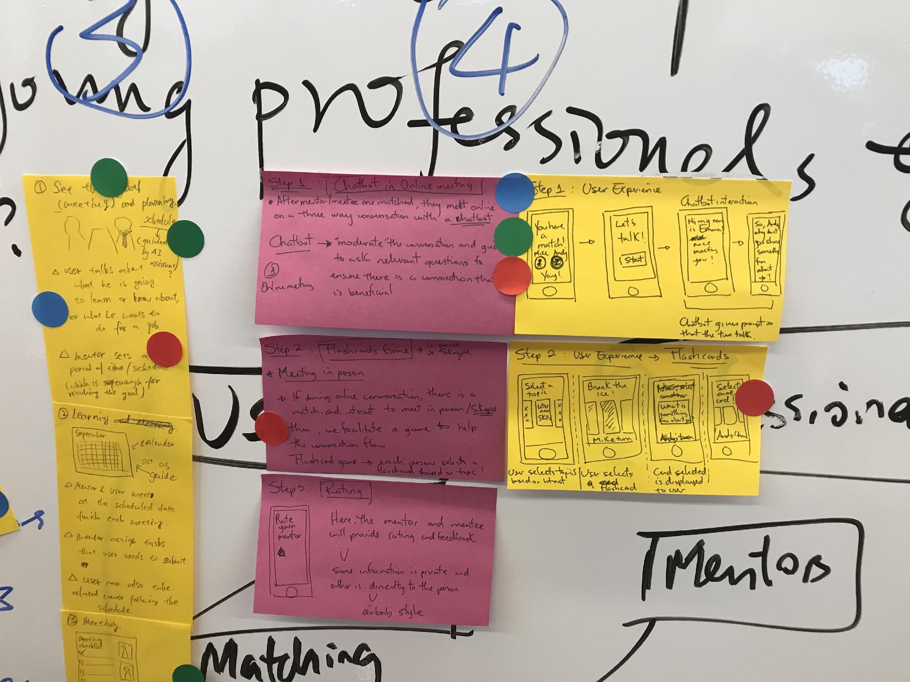
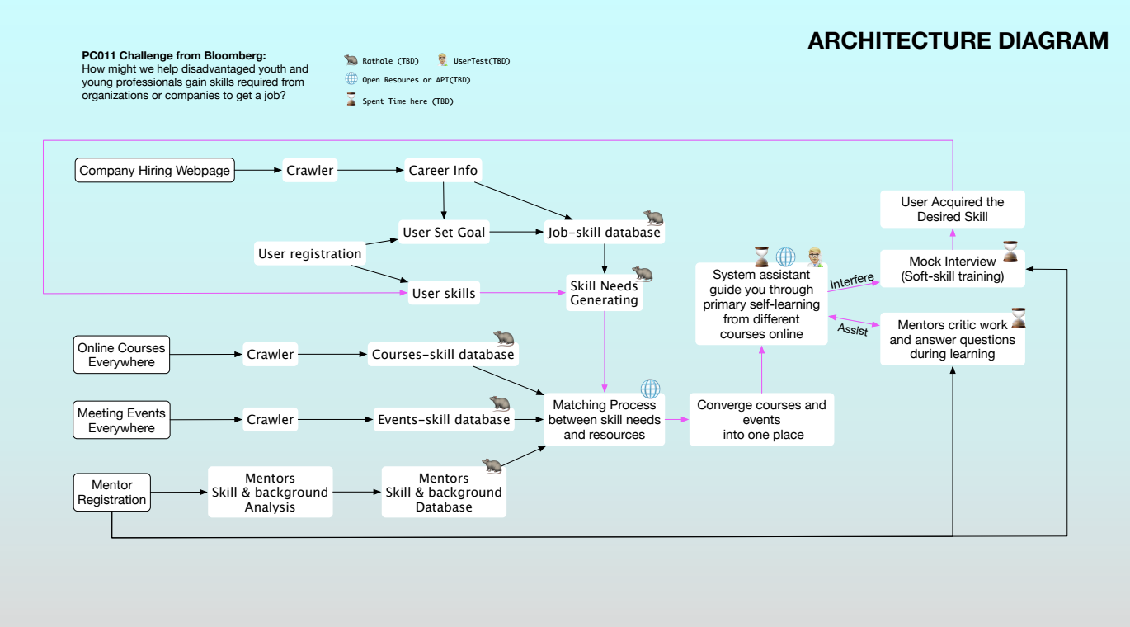
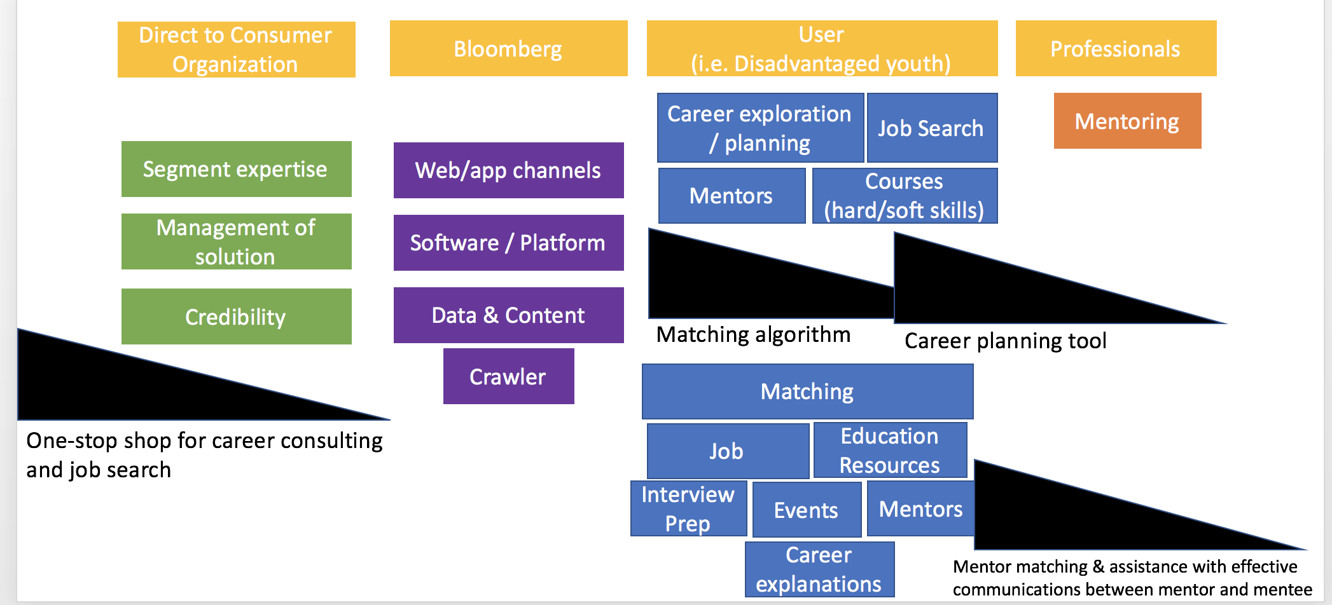
Connect people looking to support each other
Support / Social Network
Resume Builder
Quid-pro-quo
Apprenticeship Model
Online Courses Platform
HMW help disadvantaged youth gain skills?
Learn by Doing
Job Buddy
Learn from mentors in the tech industry
Mentorship platform

Slide 11
NEXT STEPS
Add Loyalty / Gamification & Scheduling “Doodle”
Final Presentation to Bloomberg
Finalize
Job Buddy Poster

Slide 12
Thanks!
Michael MBA
Mike
CS
Vincent
CS
Yi
Design
Andy
CM

